Slide 1

The Softball Recruiting Playbook
A Practical, Step-by-Step Guide for Softball Athletes & Families

Slide 2
The Real Recruiting Landscape
Only ~8% of high school athletes play college sports
Only ~1.6% of softball players reach Division I
Coaches recruit through a funnel, not open tryouts
Fit matters more than division prestige
College coaches combine multiple tools to build their recruiting boards:
Recruiting platforms and databases
Third-party services (NCSA, etc.)
High school and club coach recommendations
Direct emails from athletes
Camps, showcases, and tournaments

Slide 3
The Recruiting Funnel
Large pool of potential recruits filtered by:
Academics
Position needs
Metrics & measurables
Graduation year
Geography
Final offers go to best fit, not just best stats
WHAT THIS MEANS FOR YOU
Waiting to be discovered is not a strategy
Exposure without preparation wastes money
The goal is finding the right program — not chasing logos
Comprehensive Guide to Softball Recruiting Standards by NCSA

Slide 4
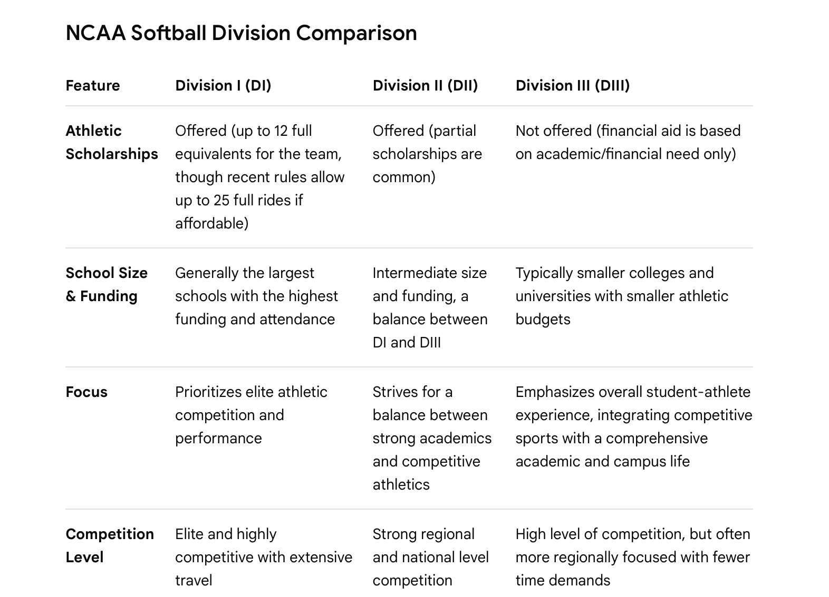

Slide 5
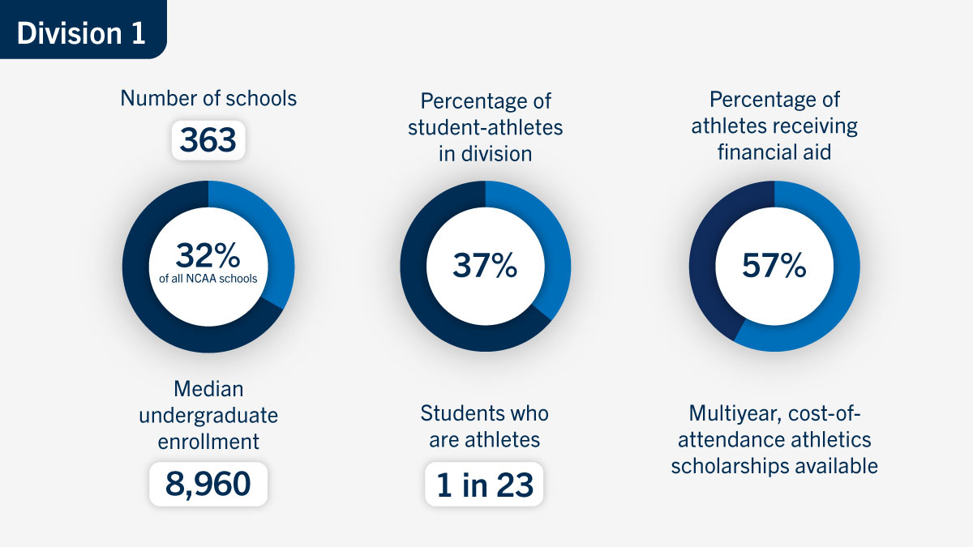
Your Sport = Your Life

Slide 6
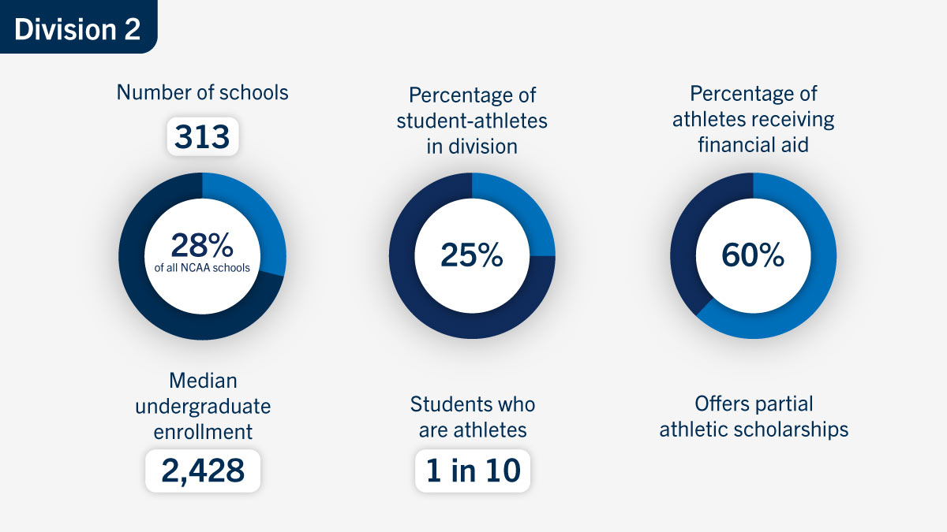
A More Balanced Approach

Slide 7
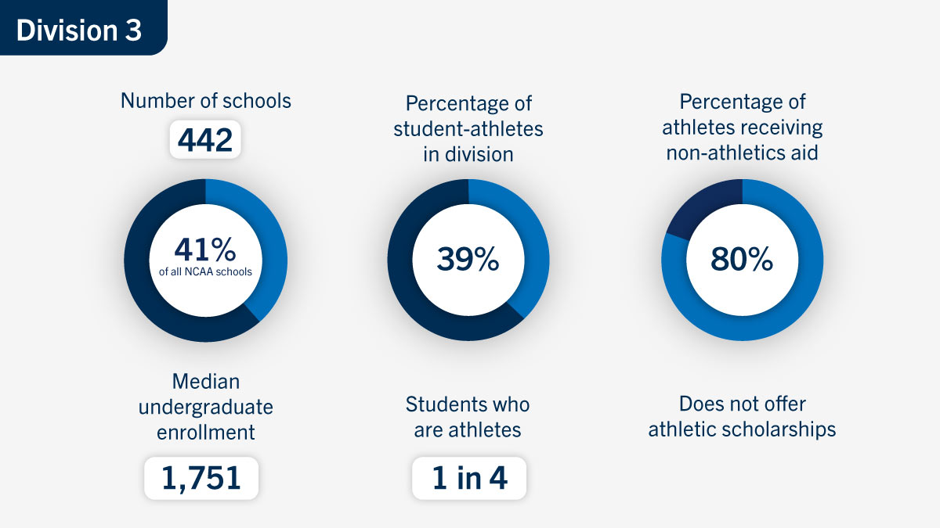
A Well-Rounded College Experience

Slide 8
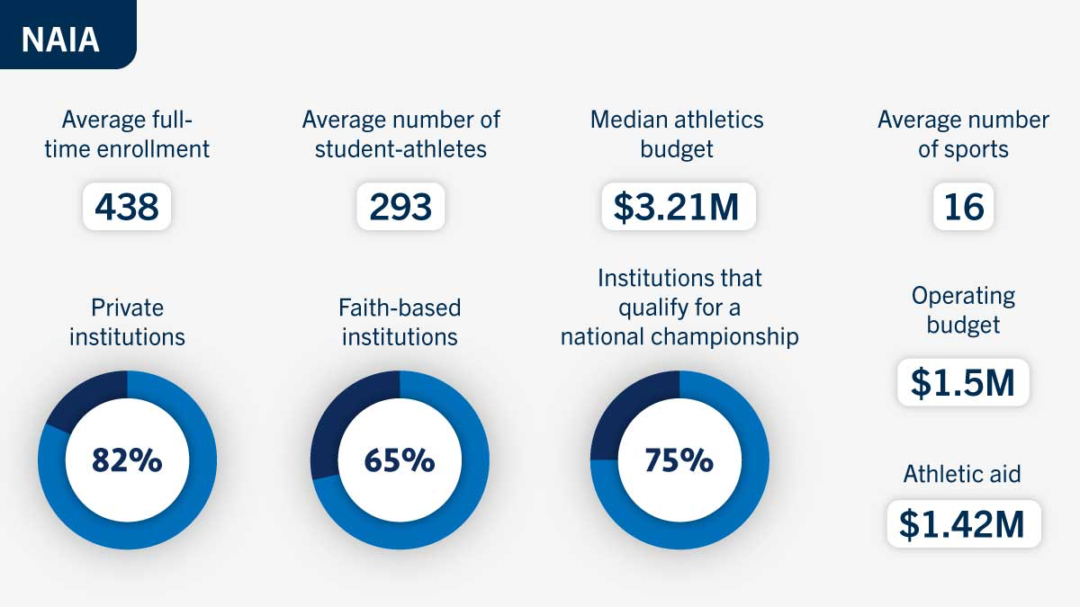

Slide 9
NJCAA: DON’T IGNORE JUNIOR COLLEGES
Junior colleges (JUCOs) are often overlooked, but they can be a great academic and athletic option. Each year, over 60,000 athletes compete across 500+ NJCAA schools.
JUCO can be a smart choice for athletes who want to:
Save money: Lower tuition and strong scholarship options
Play right away: More opportunities for immediate playing time and development
Stay eligible: Transferable general education courses keep athletes on track
Increase recruiting opportunities: Coaches value JUCO athletes for their experience and readiness

Slide 10
Recruiting Timelines
Recruiting timelines are different at every level
Understanding timing prevents panic
“Earlier” is not always “better”
Recruiting Rules
Contact Period: Full communication
Evaluation Period: Watch only
Quiet Period: On-campus only
Dead Period: No in-person contact
Athletes may contact coaches at any time

Slide 11
Division I Recruiting Timeline
Most restrictive rules
7th–8th Grade: Evaluation only
Freshman Year: Skill building, academics, video
Sophomore Year: Heavy evaluation
Sept 1 Junior Year: Communication opens
Junior Summer: Offers & visits
Senior Year: Remaining needs

Slide 12
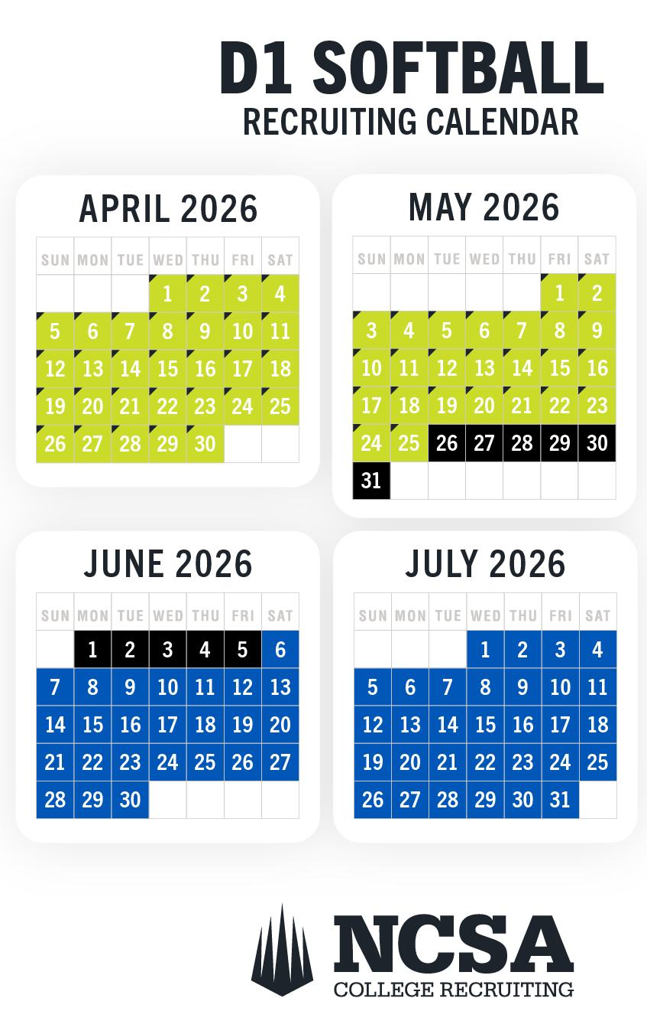
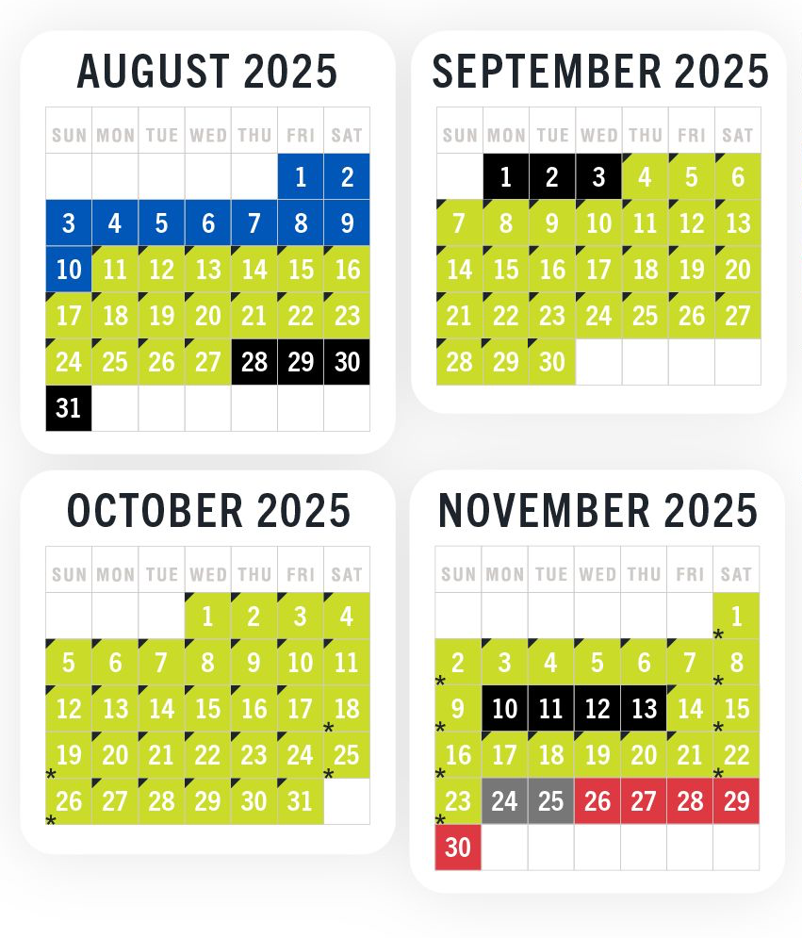
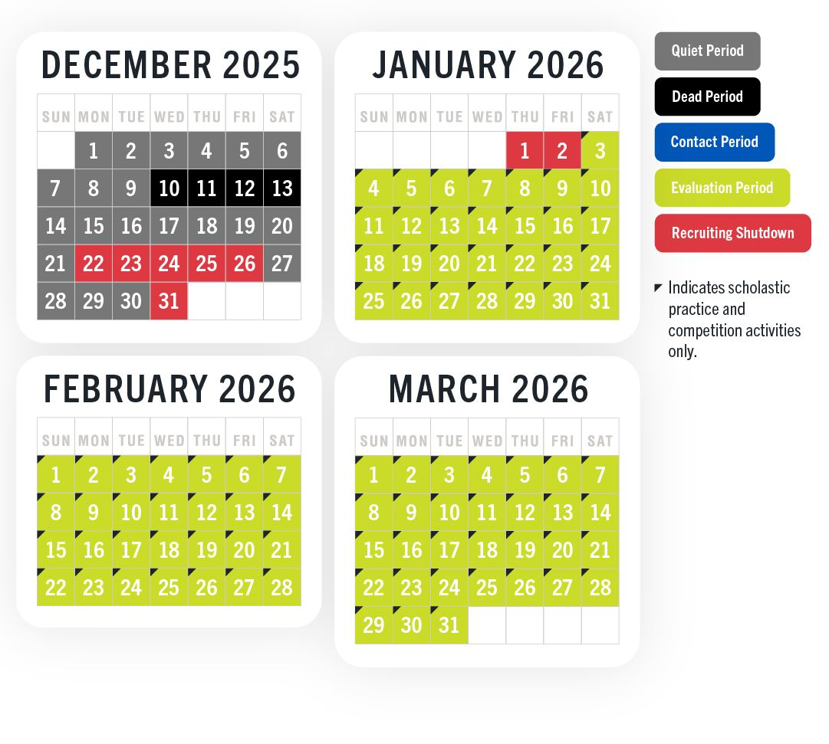

Slide 13
Division II & III Recruiting Timeline
Division II
Coaches may contact athletes at any time
Early evaluation still common
Most offers happen junior year
Senior year fills remaining roster spots
Division III
No athletic scholarships
Academics heavily prioritized
Communication starts sophomore–junior year
Likely letters & pre-reads junior–senior year

Slide 14
NAIA & JUCO Recruiting Timeline
NAIA Timeline
Communication allowed at any time
Year-round recruiting
Mix of athletic and academic aid
JUCO Timeline
Fast-moving and opportunity-driven
Strong development pathway
Strategic option — not a fallback

Slide 15
What Gets You Noticed?
Build a Strong Online Presence
Maintain an up-to-date recruiting profile with stats, highlights, academics, and contact info (X or NSCA)
Attend Camps & Showcases
Participate in events to gain exposure, build relationships, and showcase your talent.
Be Proactive in Communication
Email coaches with personalized messages, your video/profile, and reasons you’re interested
Focus on Academics
Keep grades and test scores strong to stay eligible and improve scholarship opportunities.
Take College Visits Seriously
Attend official and unofficial visits, prepare questions, and make a strong impression on coaches, players, and staff.

Slide 16
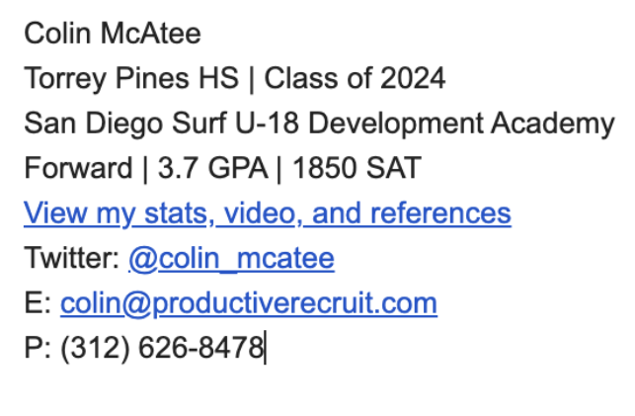
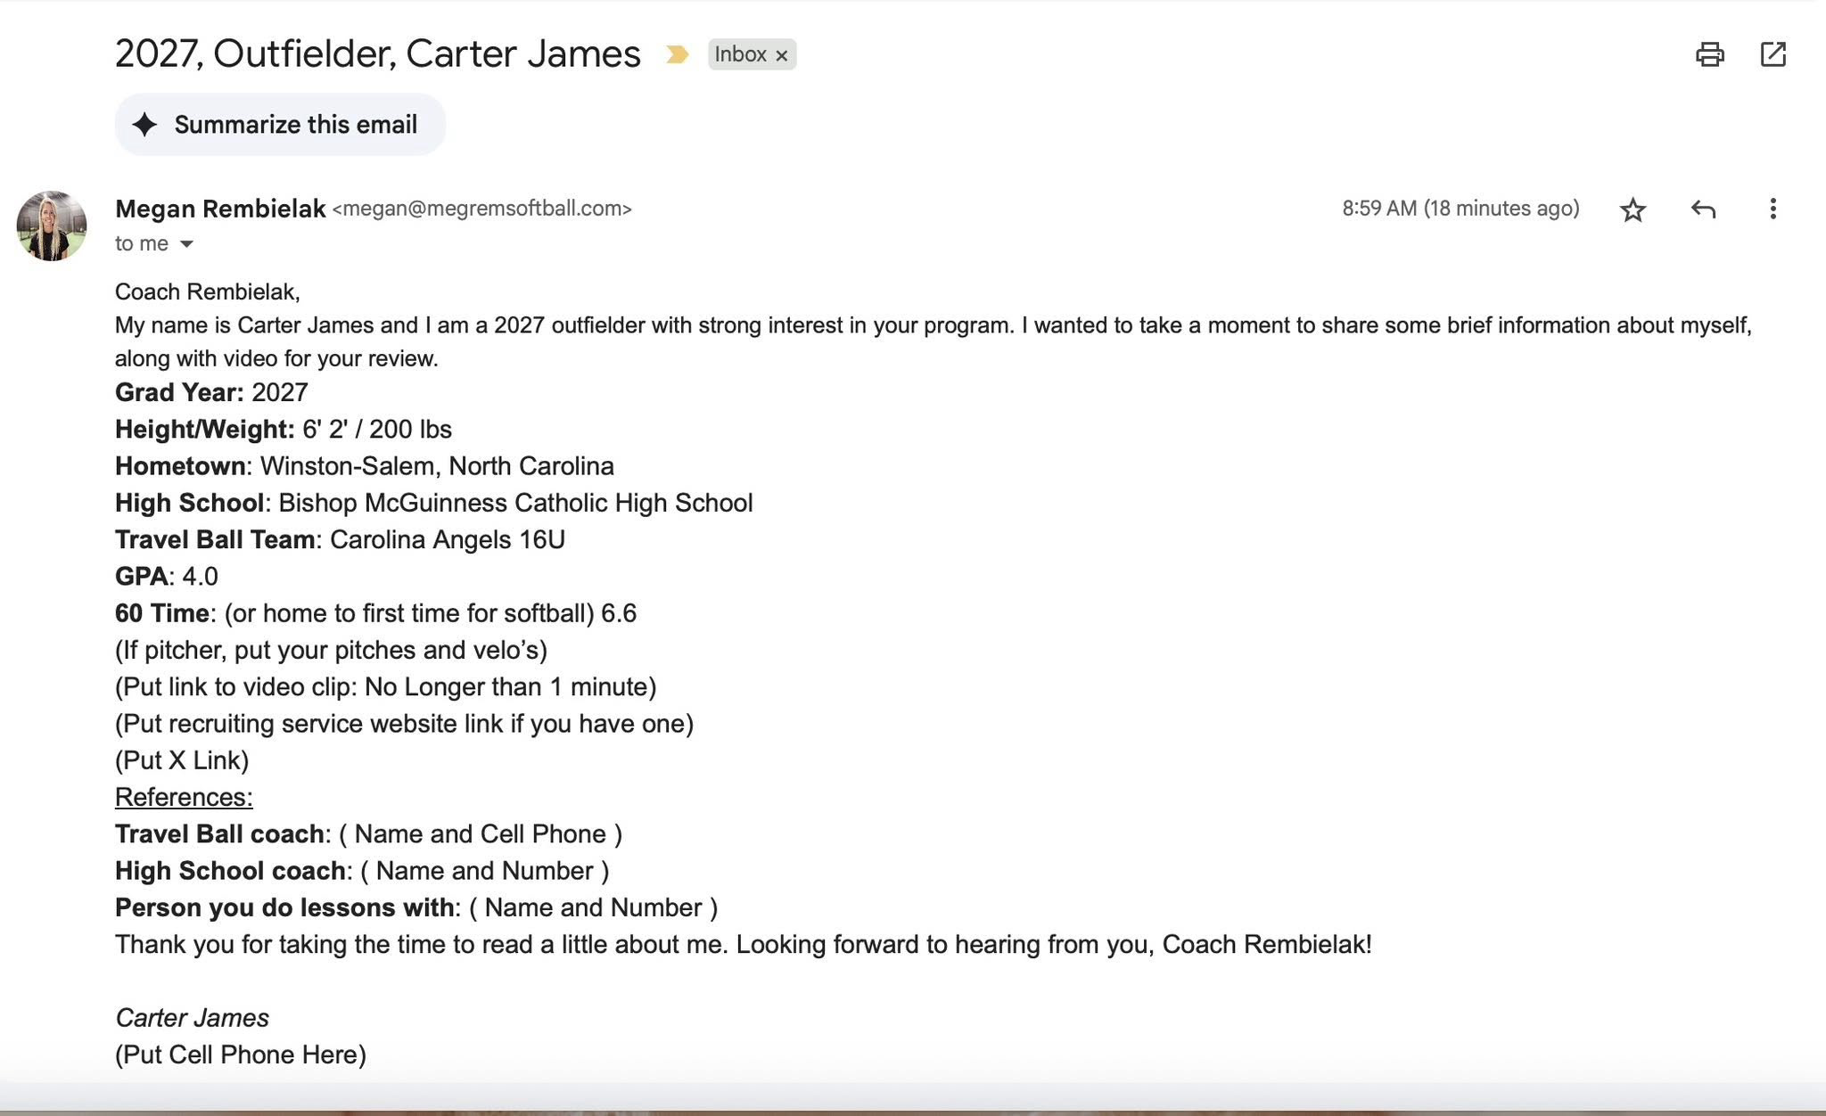
Communication
Don’t wait for college coaches to start contacting you! Instead, take the initiative to show them why you deserve to make it to the next round of the college recruiting process.
Send them updated athletic and academic stats and highlight videos with your best and most recent footage.
Subject line - name, grad year, positions
Include link to your socials at end of email
Make sure you spell the coaches name the right way
Be personal! Find a way to stand out

Slide 17
Skills Videos
Length & Format
2–3 minutes max
Coaches scan quickly — long videos won’t be watched
No music or effects
Upload to YouTube (easy to link in emails)
Hitting Video (Tee acceptable, toss/machine preferred)
Show two camera angles 6–10 swings
  Behind hitter & open swing-side
Pitcher Video
Camera ~5 ft behind the mound and open to arm side
Show 3 pitches of each best pitch
Include fastball
Second angle: camera ~3 ft behind catcher to show ball movement into glove

Slide 18
Catcher’s Skills Video
Blocking
Camera positioned ~2 ft left and 5 ft in front of the mound
Show:
  2–3 blocks straight on
  2–3 blocks to glove side
  2–3 blocks to throwing-hand side
Emphasize ball control and recovery
Pop & Throws
Show throws from both directions:
  2–4 throws filmed ~3 ft behind 3B
  2–3 throws filmed ~2 ft behind catcher
Coaches want to see clean footwork and quick release
Bunts & Throws
2 bunts along the 1B line
2 bunts up the 3B line
Camera positions:
  ~3 ft behind the plate (bunts)
  ~3 ft to the right of 1B (throws)

Slide 19
Metrics & Measurables According to NSCA
Overhand Throw Velocity
Shuffle and throw 60 ft from behind line
Radar gun positioned behind thrower
Best 3 throws out of 6
Exit Velocity
Hit off tee into net
Measure from behind batter
Best 3 of 5 swings
Pro Agility Shuttle
Test both directions
Record 2 runs — fastest time
20-Yard Sprint (Home to 1B)
Time starts on first foot movement
Stop when any part crosses finish line
Best of 2 runs
Vertical Jump
Best of 3 attempts

Slide 20
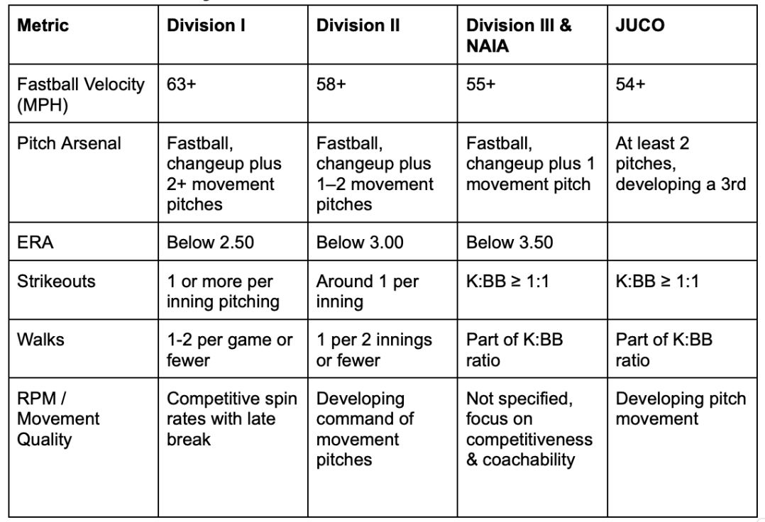
What Softball Measurables Do College Coaches Look For in a Pitcher?

Slide 21
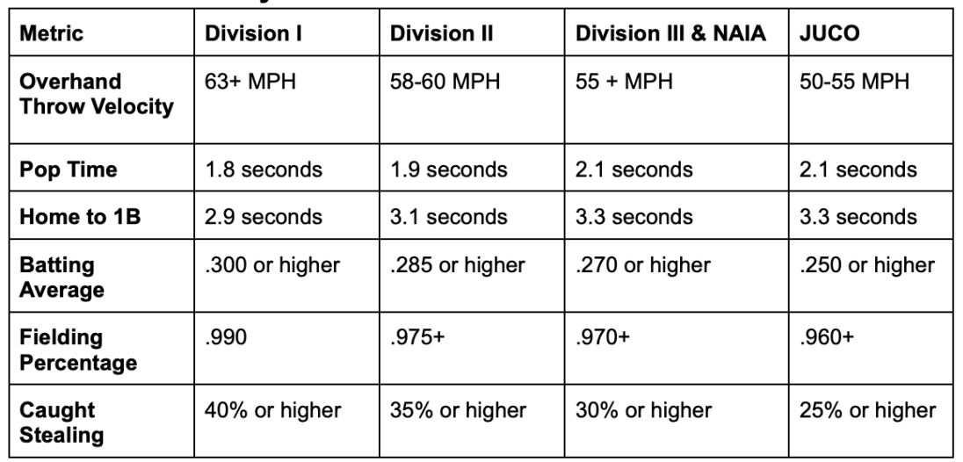
What Softball Measurables Do College Coaches Look For in a Catcher?

Slide 22
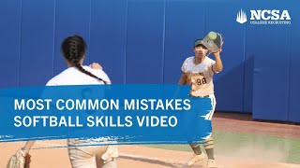
What to Avoid in a Skills Video

Slide 23

Year-by-Year Recruiting Roadmap
7th–8th: Skill development & habits
9th: Academics, first video, school research
10th: Consistent communication & exposure
11th: Visits, offers, decisions
There is a place for everyone

Slide 24
7th–8th Grade: Early Development Focus
Primary Focus
Skill development & athletic growth
Learning how to compete consistently
Starting Metrics
Establish baseline metrics (not comparisons)
Track improvement, not rankings
Training Priorities
Mechanics, movement quality, fundamentals
Strength, speed, coordination
Building Strong Habits
Coachability
Work ethic
Body language
Accountability
Recruiting Actions
Create a starter skills video
Begin a list of schools you might be interested in

Slide 25
9th Grade: Exploration & Foundation
School Research
Build a list of schools and start researching
Cast a wide net across multiple division levels
Include reach, realistic, and safety options
Important Reality Check
Generic letters, questionnaires, or a coach watching one game does NOT mean you are being recruited
Real interest looks like:
  Personalized emails
  Phone calls
  Coaches coming to see you play
  Visit invitations
Academic Foundation
Grades matter early
Build strong academic habits now

Slide 26
9th Grade: Recruiting Tools
Recruiting Tools to Build
Highlight film
Recruiting social media
Email template for coach communication
Exposure Opportunities
Camps & clinics
Learning how to communicate professionally

Slide 27
10th Grade: Engagement & Exposure
Coach Communication
Begin consistent communication with coaches
Respond promptly and professionally
Exposure
Showcases & targeted events
Summer recruiting is critical
Organization
Create a complete player profile
Send thank-you emails after events and camps

Slide 28
11th Grade: Decision Year
Recruiting Decisions
Official and unofficial visits
Understanding offer types
Comparing opportunities
Mindset Shift
You are interviewing them as much as they are evaluating you
Ask questions about:
  Role
  Development
  Culture
  Academics

Slide 29
Parents’ Role in the Recruiting Process
Support, Don’t Pressure
Encourage your athlete while letting them take ownership of their recruiting journey
Let the Athlete Lead
Your child should carry their own equipment, manage their own schedule, and take the initiative—this is their journey
Help Organize
Help track timelines and deadlines, but let the athlete learn how to organize (it's a great skill for college!)
Proofreader
Help review emails or forms but let the athlete be the main contact with coaches
Emotional Guidance
Celebrate wins, offer perspective on setbacks, and help manage stress
Help Evaluate Opportunities
Guide discussions on fit—athletic, academic, and social—without making the final decision

Slide 30
THERE IS NO RUSH
THERE IS A PLACE FOR EVERYONE
The right fit is more important than the fastest commitment.

Slide 31

Thank you!

